Slide 1
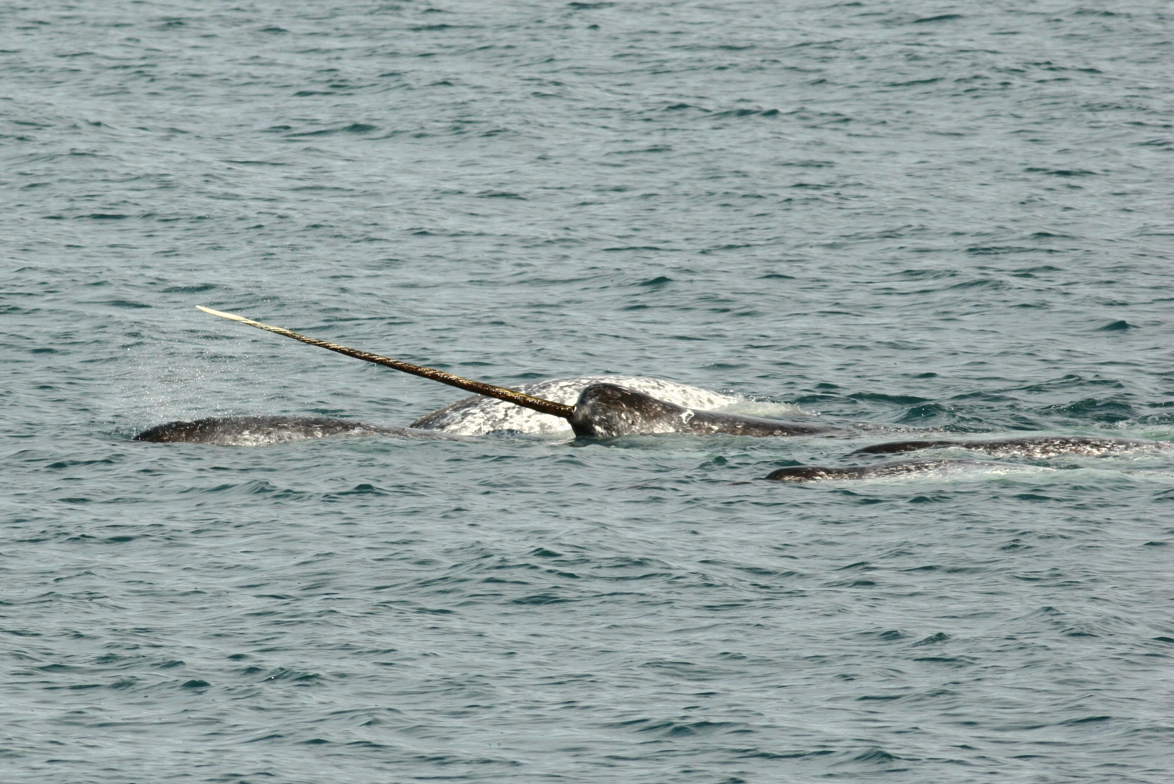

Handling marine movement data
Marie Auger-Méthé
Canadian Research Chair Tier II in Statistical Ecology
Institute for the Oceans & Fisheries
Dept. of Statistics
University of British Columbia

Slide 2
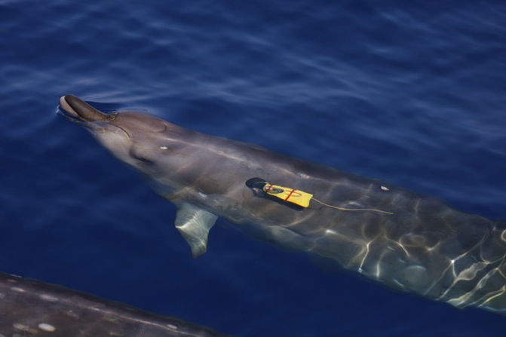
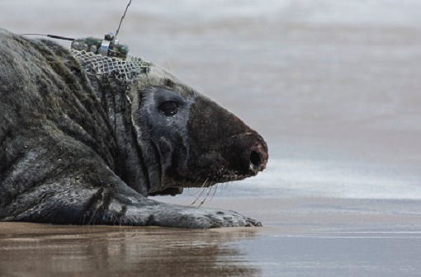
Problems with marine tracking
GPS doesn’t work underwater
Animals don’t surface long enough to get to GPS location
© Robin Baird
© Damian Lidgard
Notes:
GPS doesn’t work underwater. But you might think but what about the big marine animals that come to the surface to breath. We could prpobably use GPS on these gyes, right. Well actually no. It takes a long time for a GPS unit to get all of the information from the satelitte to be able to estimate a location. That normal GPS is useless even for amrin mammals

Slide 3
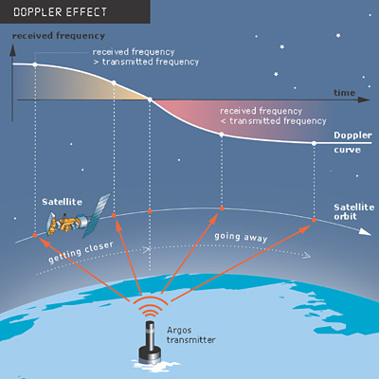


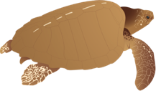

Alternatives for animals that surface
Fastloc GPS
Argos
More accurate More expensive
Less accurate Less expensive

Slide 4
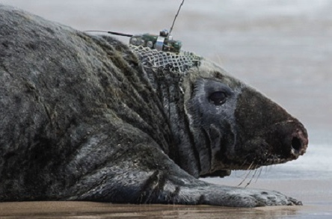
Fastloc GPS
© Damian Lidgard
Notes:
Fastlock gps doesn’t have to get as much information from the satellites than conventional GPS because it doesn’t estimate the location on board. It just calculates the distance between the satellites and the units, in terms of time in takes for the signal emitted by the satellite to reach the unit. And then you calculate the position on your computer in the lab, by gathering the satellites navigation information (so where the satellite are). This means that you can get a location even if the animal comes out for only a few seconds and it also means that the battery packs are smaller than conventional GPS. So those are really great, but really expensive

Slide 5
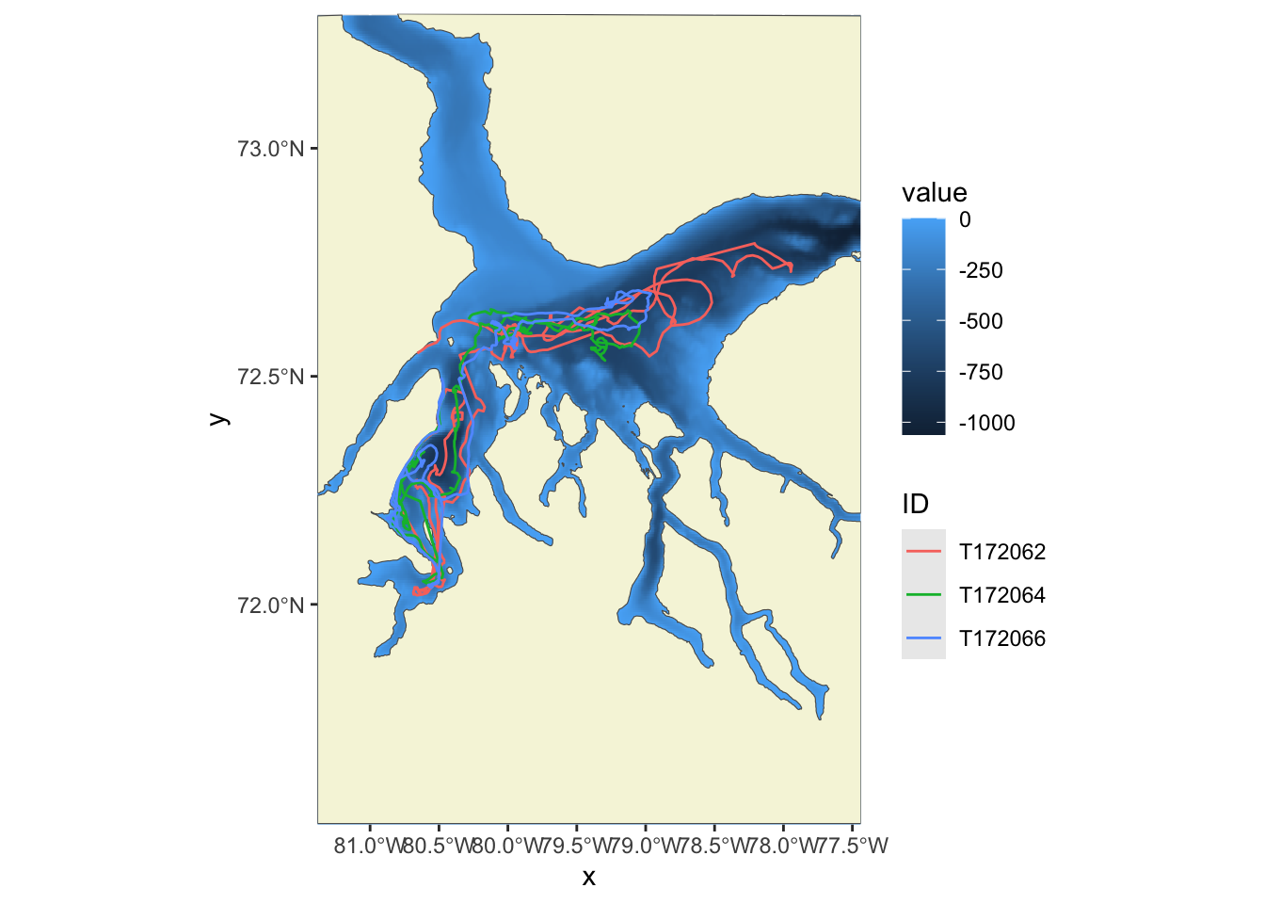

Fastloc GPS
Can be used on animals that surface for only 10s of milliseconds
Accurate <200 m

Slide 6
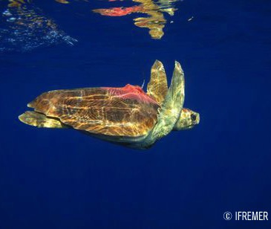
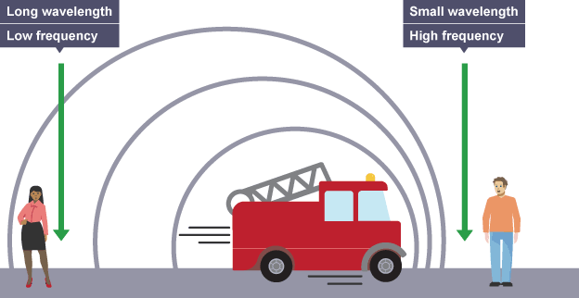
Argos
Notes:
So a lot of people are using Argos technology for air breathing animals, instead of Fastloc GPS. This also requires the animal to surface, but the units are a bit cheaper. Argos tags get locations through the doppler effects. So that the idea that wavelengths of a moving object changes as it moves. That’s the reason why the sounds of a siren has higher frequency when it’s moving toward you rather than away from you.

Slide 7
Argos
Notes:
So in the context of Argos tag, orbiting satellite measure emitted sounds multiple times, and use the change in frequency to estimate the location of the tag.

Slide 8
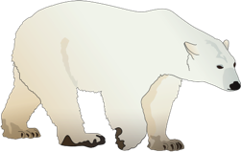
Argos
Accuracy relies on the number of successive satellite uplinks
For marine species, low accuracy
error of 4−36 km
Location quality:
3, 2, 1 0, A, B, Z
Taken at irregular time
Argos locations
Estimated true locations
GPS locations
Auger-Méthé et al. (2017) Marine Ecology Progress Series
Notes:
Argos system to get location and get info from tag

Slide 9
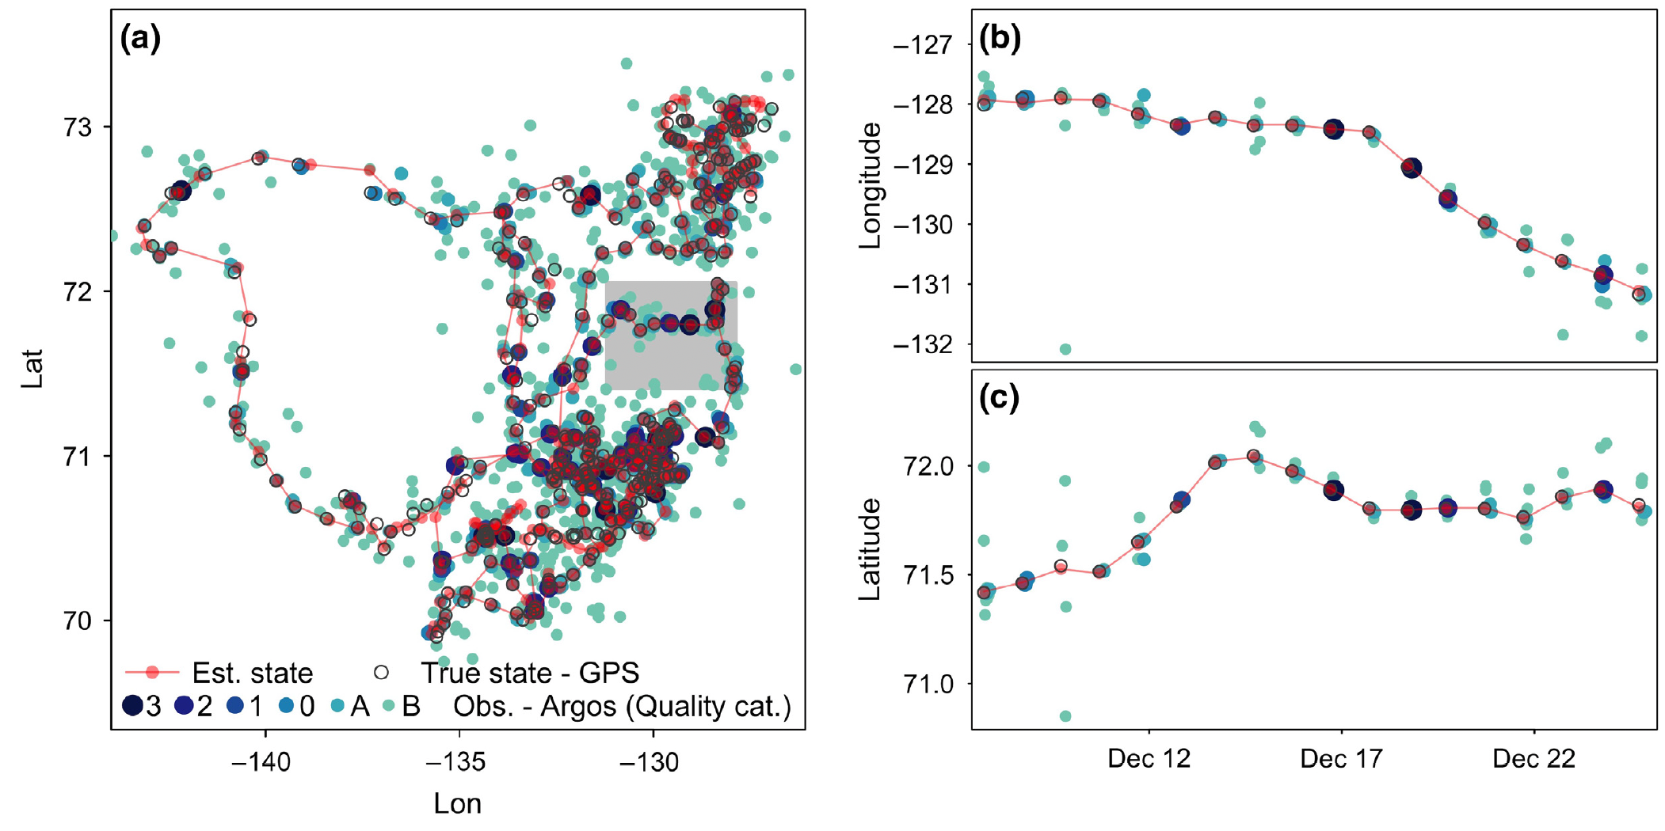
Argos
Auger-Méthé et al. (2021) Ecological Monographs

Slide 10
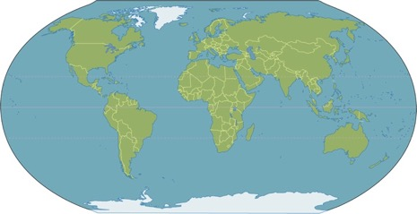
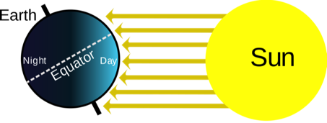
Alternative for animals that stay under (or small animals)
Light-based geolocation
Latitudes use daylength
Longitudes use time difference between local and Greenwich time
12:00
22:00

Slide 11
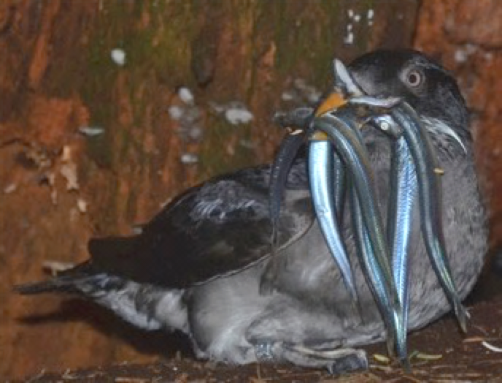
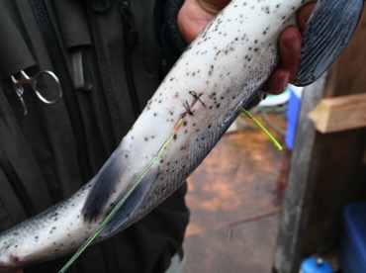
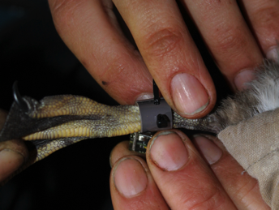
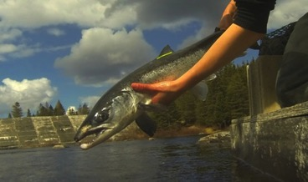
Light-based geolocation
Photos: Katharine Studholme, M. Drever
Notes:
One common alternative is light-based geolocation, sometime referred as GLS. GLS tags are small loggers, so they can be used on bird species, we see here an example of GLS leg tag on a rhinocerors auklets, which are mid-size birds. They work under water so they can be used on the many fish species that don’t surface. Here we see a tag on a Atlantic salmon.

Slide 12
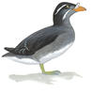
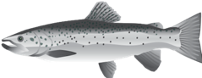
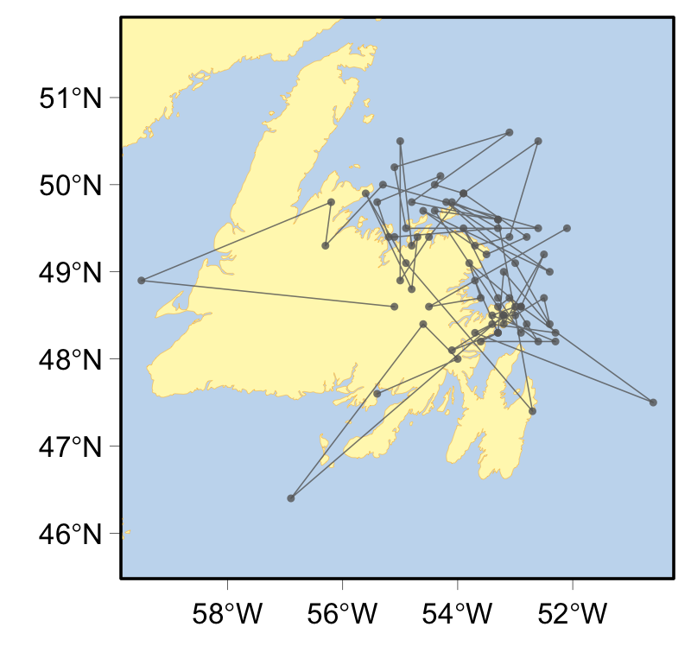
Light-based geolocation
Rhinoceros auklet
Atlantic salmon
Very inaccurate data
Error 200km
Notes:
So alternative technology like light-based geolocation and Argos tags are great and allow us to follow marine specie, but the data is very inaccurate, especially compare to GPS data. So for example, on the left we are seeing the track of a salmon that was tag in newfoundland and it looks likes it’s walking on land and crossing in a day an island that’ 650km across. So pretty unlikely. And on the right we are seeing the movement of a ringed seal with a Argos tag. And it looks like it’s crossing from Canada to Greenland in a few hours, which is also pretty unlikely.
SO have to weight that when you are designing a study. For example it really doesn’t make sense to you ligh-based geolocation alone to look at the movement of species that doesn’t move long distance. Because Light-based geolocation has a mean error of 200k, so if you animal doesn’t move al ot, it’s owrth it.

Slide 13
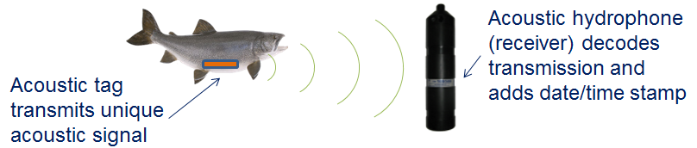

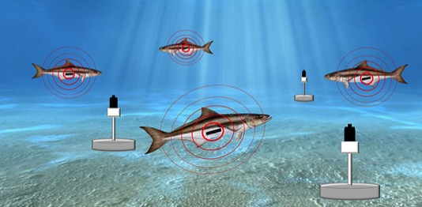
Accoustic tracking
M.A.T.O.S.
F.W.C. 2016
Notes:
-More recently studies are tagging animals with acoustic tags that transmit unique acoustic signals for each individual that can be picked up by transmitters.
-Tagged aquatic animals are monitored with continuously expanding arrays of fixed underwater receivers which provides a wealth of spatial information in addition to monitoring tags.
-only way to track animals that stay underwater for most of their lives (i.e. most fish) is through this system
-that’s why in recent years there has been an increasing amount of studies that use acoustic receivers

Slide 14
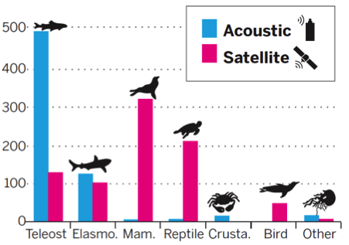
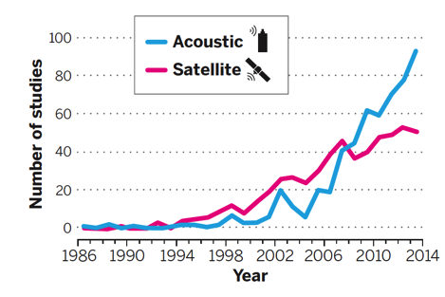
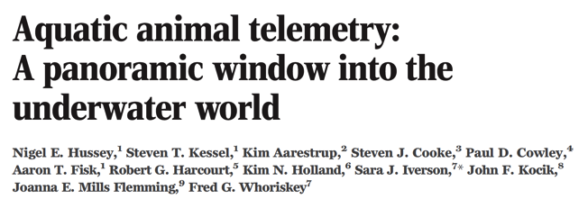

Increase in telemetry studies

Slide 15
Comparison between methods
Irregular in time
Light-based geolocation
Fastloc GPS
Argos
Low
High
Error

Slide 16
How do we handle error and irregular time steps?

Slide 17
Irregular time steps
Continuous time models
Split tracks with data gap
Regularize the time series
Simple interpolate
Prediction from a more complex model

Slide 18
State-space model to handle error
Process equation:
x_{t} = f(x_{t-1}) + η_{t}
State
Behavioural
mechanism
Process
noise
Measurement equation:
y_{t} = g(x_{t}) + ε_{t}
Data
Observation
mechanism
Measurement
error
Notes:
Our measurement equation models the observation at time t, y_t, and it’s also often split into two parts.
The first part is a deterministic function that describes the observation mechanism and is a function of the true state at time t, for example would account for any kind of systematic bias in your observation.
The second part, epsilon t, is the stochastic part that accounts for the measurement error.
And I haven’t written the parts that describes the process noise and measurement error, but for now, you can think of them as being normally distributed. We will see later that we are not restricted to Gaussian distributions.

Slide 19
State-space model to handle error
Process equation:
x_{t} = f(x_{t-1}) + η_{t}
x_{t-1}
x_{t}
x_{t+1}
State
Behavioural
mechanism
Process
noise
Measurement equation:
y_{t-1}
y_{t}
y_{t+1}
y_{t} = g(x_{t}) + ε_{t}
Data
Observation
mechanism
Measurement
error
Notes:
We can visualize this model, where the arrows represent the relationships we are modelling.

Slide 20
State-space model to handle error
Process equation:
x_{t} = f(x_{t-1}) + η_{t}
Temporal autocorrelation
x_{t-1}
x_{t}
x_{t+1}
State
Behavioural
mechanism
Process
noise
Measurement equation:
y_{t-1}
y_{t}
y_{t+1}
y_{t} = g(x_{t}) + ε_{t}
Data
Observation
mechanism
Measurement
error
Notes:
So the process equation models the autocorrelation, usually with a Markov chain, which just means that your state at time t only depends on the previous state.
And then the measurement equation models what you expect to see given the true state, so the pink arrows. And the graph shows that we assume the observations are conditionally independent.
The key here is that autocorrelation and model structure allows the model to differentiate between the process noise and measurement error, and thereby it allows us to estimate (predict) the states, so to get better prediction of the hidden process.

Slide 21
State-space models
Two-step approach (today’s focus)
Step 1: simple model to remove error (and regularize)
Step 2: analysis of interest
(e.g., resource selection function)
Pros:
Many R packages
Fast to fit
Con:
don’t propagate error (except if we use multiple imputation)
Model that handles error and includes analysis of interest (Friday’s focus)
Pro:
propagate error
Cons:
Often involves hard-coding model
Often slow

Slide 22
State-space models
Two-step approach (today’s focus)
Step 1: simple model to remove error (and regularize)
Step 2: analysis of interest
(e.g., resource selection function)
Pros:
Many R packages
Fast to fit
Con:
don’t propagate error (except if we use multiple imputation)
Model that handles error and includes analysis of interest (Friday’s focus)
Pro:
propagate error
Cons:
Often involves hard-coding model
Often slow

Slide 23
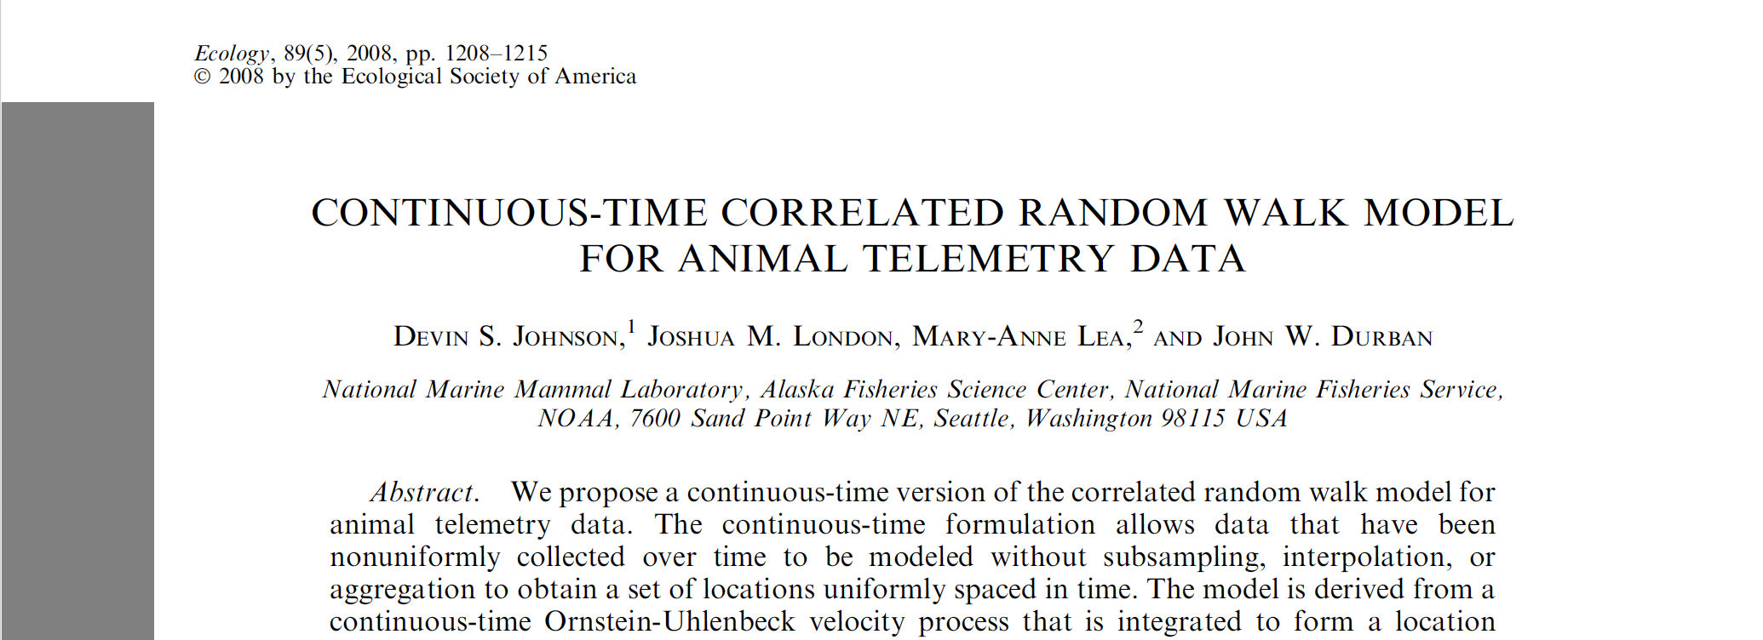

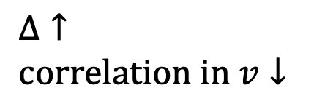
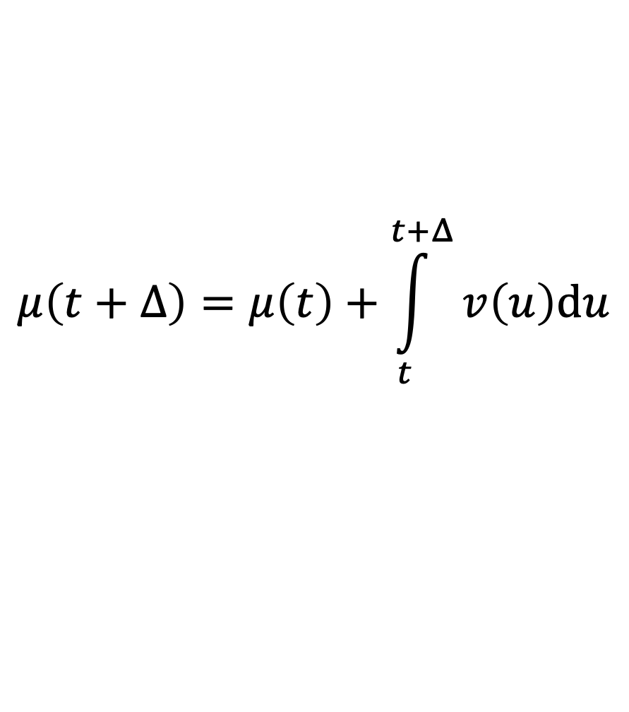
CTCRW with crawl (via momentuHMM)
Process equation (basic concept):
How quickly the temp. correlation → 0
Velocity (speed)
$$v\left(t+Δ\right)=e^{−βΔ}v\left(t\right)$$
$$Δ↑ \\ correlation in v↓$$
Location
$$μ\left(t+Δ\right)=μ\left(t\right)+\int_{t}^{t+Δ}{v\left(u\right)du}$$
Notes:
Each direction independent.
“Essentially, the location at time t is the ‘‘sum’’ of the
steps plus a starting location”

Slide 24
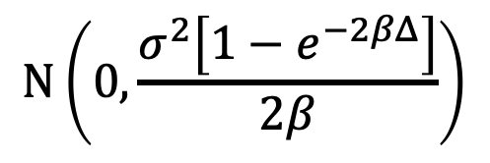
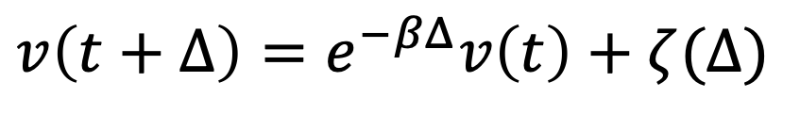
CTCRW with crawl (via momentuHMM)
Process equation (basic concept):
How quickly the temp. correlation → 0
Velocity (speed)
$$v\left(t+Δ\right)=e^{−βΔ}v\left(t\right)+ζ(Δ)$$
$$Δ↑ \\ correlation in v↓$$
$$N\left(0,\frac{σ^{2}\left[1−e^{−2βΔ}\right]}{2β}\right)$$
Location
$$μ\left(t+Δ\right)=μ\left(t\right)+\int_{t}^{t+Δ}{v\left(u\right)du}$$
Notes:
Each direction independent.
“Essentially, the location at time t is the ‘‘sum’’ of the
steps plus a starting location”

Slide 25
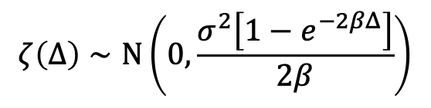
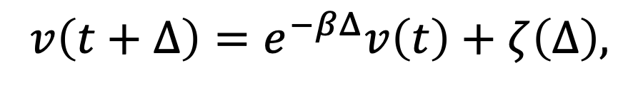
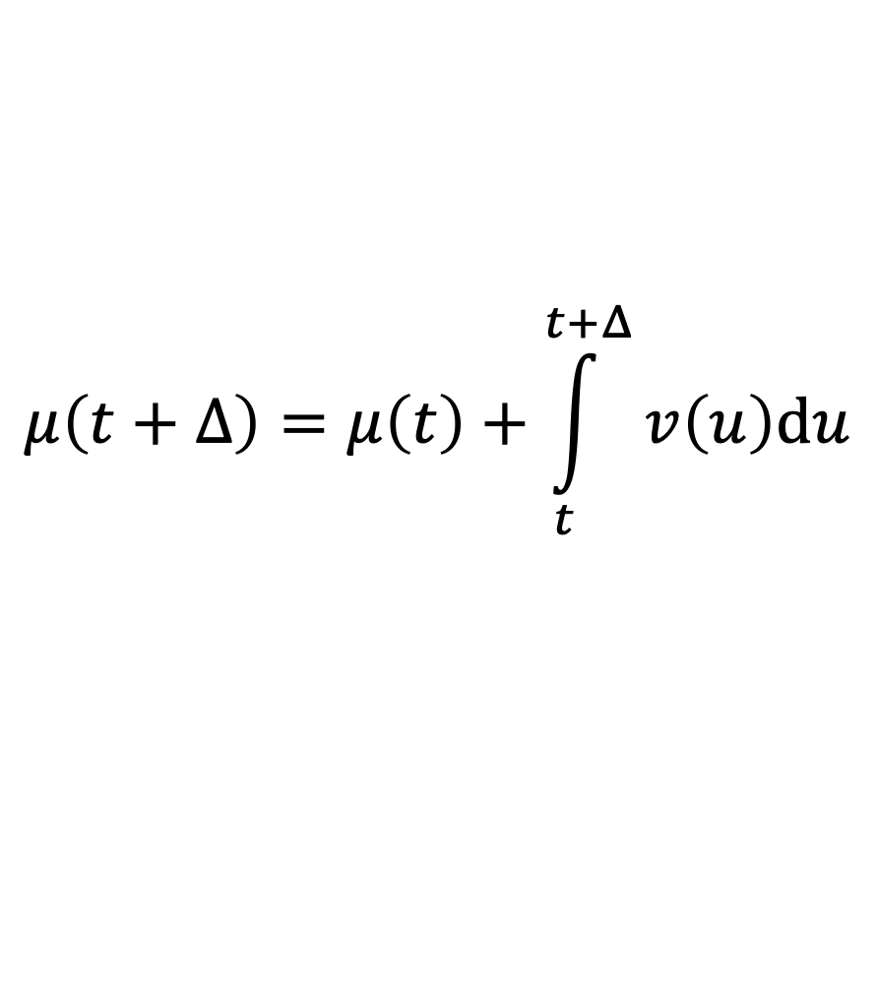
CTCRW with crawl (via momentuHMM)
Process equation (basic concept):
Velocity (speed)
$$v\left(t+Δ\right)=e^{−βΔ}v\left(t\right)+ζ\left(Δ\right),$$
$$ζ\left(Δ\right)∼N\left(0,\frac{σ^{2}\left[1−e^{−2βΔ}\right]}{2β}\right)$$
$$μ\left(t+Δ\right)=μ\left(t\right)+\int_{t}^{t+Δ}{v\left(u\right)du}$$
Location
Measurement equation:
$$y\left(t\right)=μ\left(t\right)+ε\left(t\right), ε\left(t\right)∼N\left(0,σ_{m}^{2}\right)$$
Notes:
Each direction independent.
“Essentially, the location at time t is the ‘‘sum’’ of the
steps plus a starting location”

Slide 26
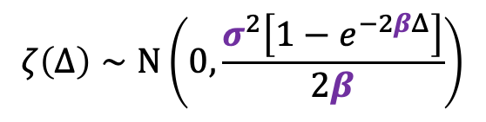
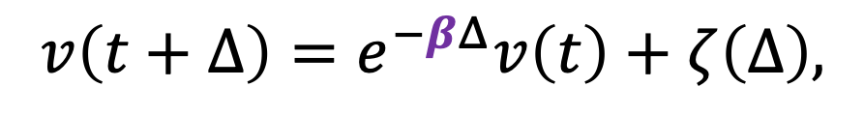
CTCRW with crawl (via momentuHMM)
Process equation (basic concept):
Velocity (speed)
$$v\left(t+Δ\right)=e^{−βΔ}v\left(t\right)+ζ\left(Δ\right),$$
$$ζ\left(Δ\right)∼N\left(0,\frac{σ^{2}\left[1−e^{−2βΔ}\right]}{2β}\right)$$
$$μ\left(t+Δ\right)=μ\left(t\right)+\int_{t}^{t+Δ}{v\left(u\right)du}$$
Location
Measurement equation:
$$y\left(t\right)=μ\left(t\right)+ε\left(t\right), ε\left(t\right)∼N\left(0,σ_{m}^{2}\right)$$
Notes:
Each direction independent.
“Essentially, the location at time t is the ‘‘sum’’ of the
steps plus a starting location”

Slide 27
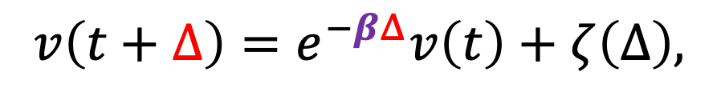
CTCRW with crawl (via momentuHMM)
Process equation (basic concept):
Velocity (speed)
$$v\left(t+Δ\right)=e^{−βΔ}v\left(t\right)+ζ\left(Δ\right),$$
$$ζ\left(Δ\right)∼N\left(0,\frac{σ^{2}\left[1−e^{−2βΔ}\right]}{2β}\right)$$
$$μ\left(t+Δ\right)=μ\left(t\right)+\int_{t}^{t+Δ}{v\left(u\right)du}$$
Location
Measurement equation:
$$y\left(t\right)=μ\left(t\right)+ε\left(t\right), ε\left(t\right)∼N\left(0,σ_{m}^{2}\right)$$
Notes:
Each direction independent.
“Essentially, the location at time t is the ‘‘sum’’ of the
steps plus a starting location”

Slide 28
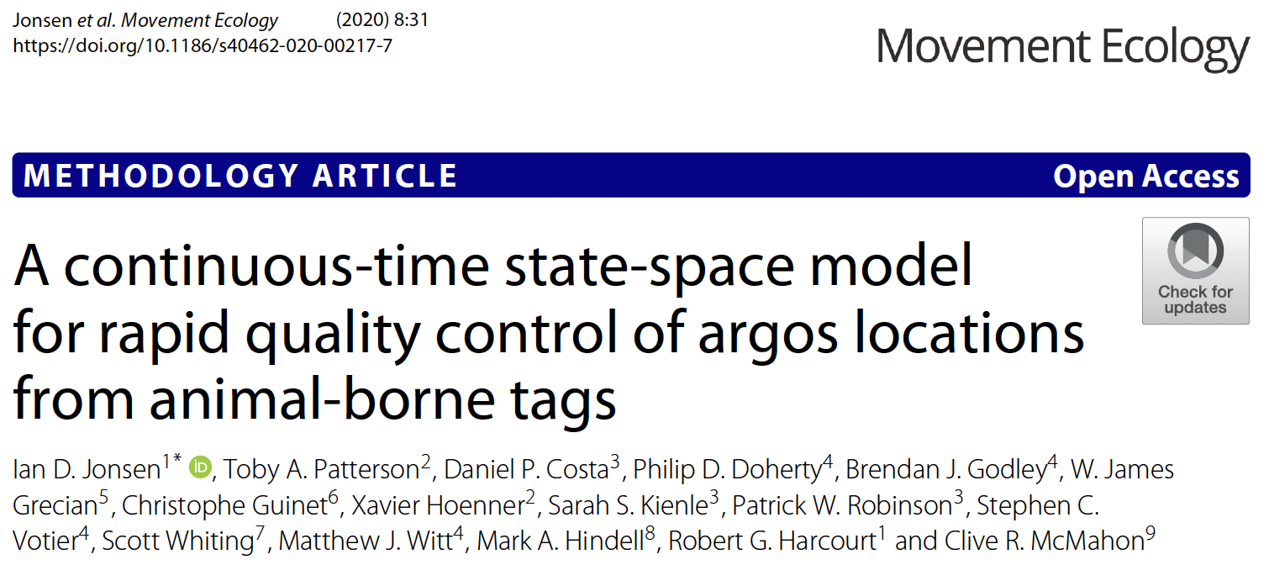
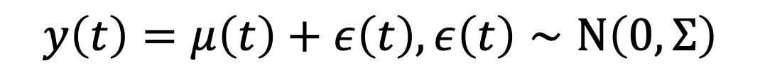
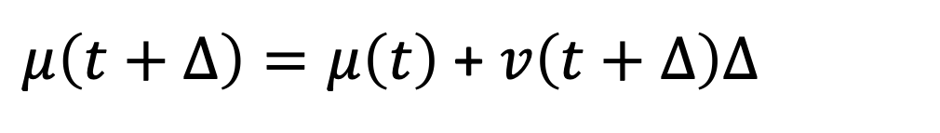
aniMotum – CRW version
Process equation:
Velocity (speed)
$$v\left(t+Δ\right)=v\left(t\right)+ζ\left(Δ\right), ζ\left(Δ\right)∼N\left(0,2DΔ\right)$$
Location
$μ\left(t+Δ\right)=μ\left(t\right)$ + $v\left(t+Δ\right)Δ$
Measurement equation:
$$y\left(t\right)=μ\left(t\right)+ε\left(t\right), ε\left(t\right)∼N\left(0,Σ\right)$$

Slide 29
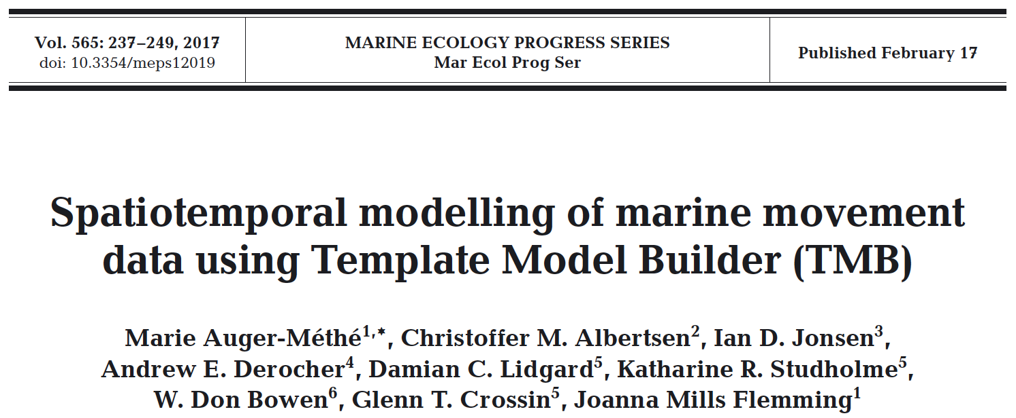
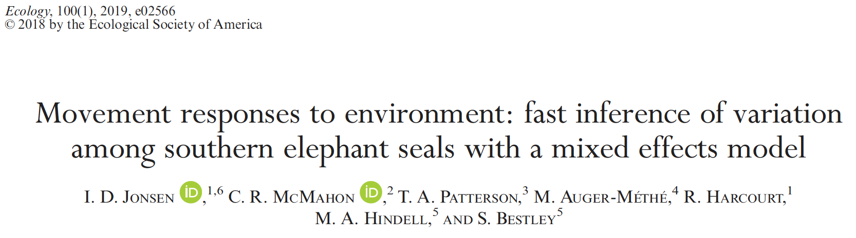
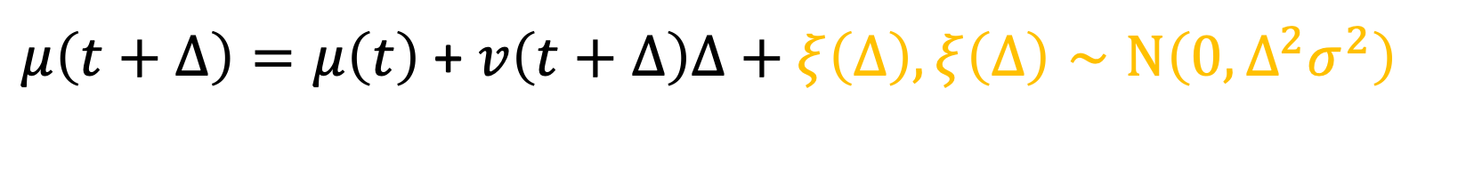
aniMotum – mp version
Process equation:
Velocity (speed)
$$v\left(t+Δ\right)=γ(t+Δ)v\left(t\right)$$
Location
$μ\left(t+Δ\right)=μ\left(t\right)$ + $v\left(t+Δ\right)Δ+ξ\left(Δ\right),ξ\left(Δ\right)∼N\left(0,Δ^{2}σ^{2}\right)$
Measurement equation:
$$y\left(t\right)=μ\left(t\right)+ε\left(t\right), ε\left(t\right)∼N\left(0,Σ\right)$$

Slide 30
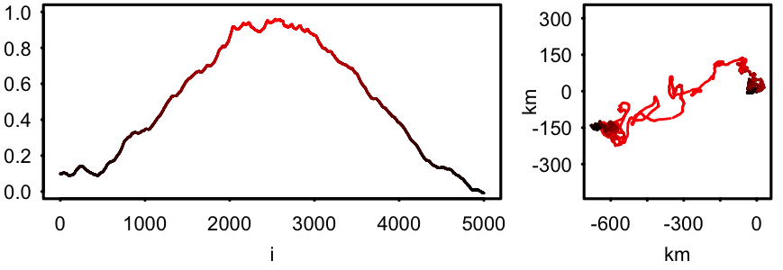
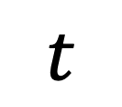

aniMotum – mp version
Process equation:
$$logit\left(γ(t+Δ)\right)=logit\left(γ(t)\right)+ς\left(Δ\right), ς\left(Δ\right)∼N\left(0,{Δσ}_{γ}^{2}\right)$$
Velocity (speed)
$$v\left(t+Δ\right)=γ(t+Δ)v\left(t\right)$$
Location
$$γ(t)$$
$μ\left(t+Δ\right)=μ\left(t\right)$ + $v\left(t+Δ\right)Δ+ξ\left(Δ\right),ξ\left(Δ\right)∼N\left(0,Δ^{2}σ^{2}\right)$
Measurement equation:
$$y\left(t\right)=μ\left(t\right)+ε\left(t\right), ε\left(t\right)∼N\left(0,Σ\right)$$
$$t$$
Notes:
How changes in gamma affect

Slide 31
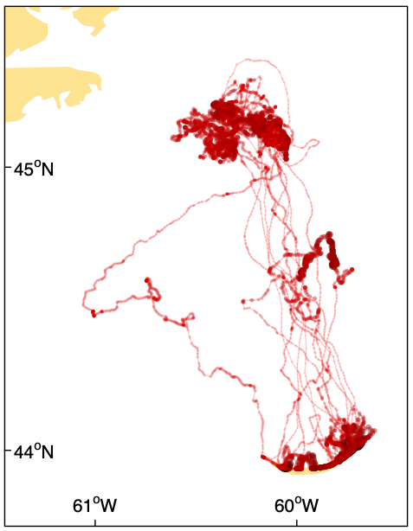
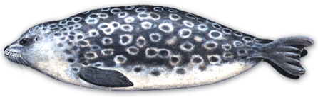

aniMotum – mp version
Process equation:
$$logit\left(γ(t+Δ)\right)=logit\left(γ(t)\right)+ς\left(Δ\right), ς\left(Δ\right)∼N\left(0,{Δσ}_{γ}^{2}\right)$$
Velocity (speed)
$$v\left(t+Δ\right)=γ(t+Δ)v\left(t\right)$$
Location
$μ\left(t+Δ\right)=μ\left(t\right)$ + $v\left(t+Δ\right)Δ+ξ\left(Δ\right),ξ\left(Δ\right)∼N\left(0,Δ^{2}σ^{2}\right)$
$$γ(t)$$
Measurement equation:
1
$$y\left(t\right)=μ\left(t\right)+ε\left(t\right), ε\left(t\right)∼N\left(0,Σ\right)$$
0
Notes:
How changes in gamma affect

Slide 32
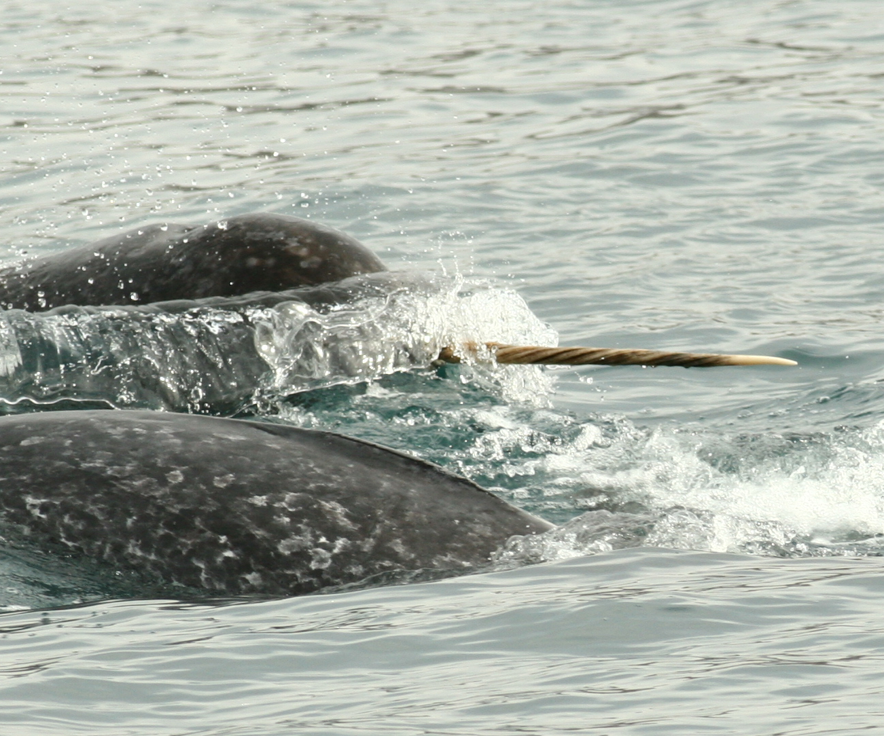
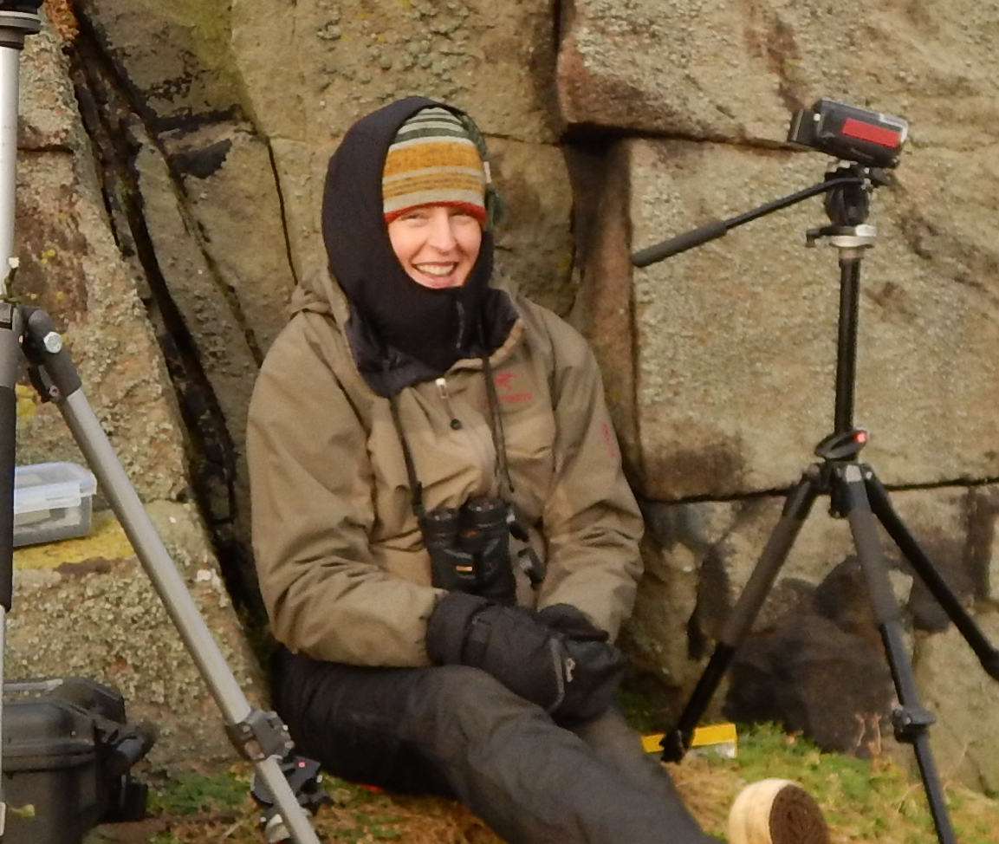
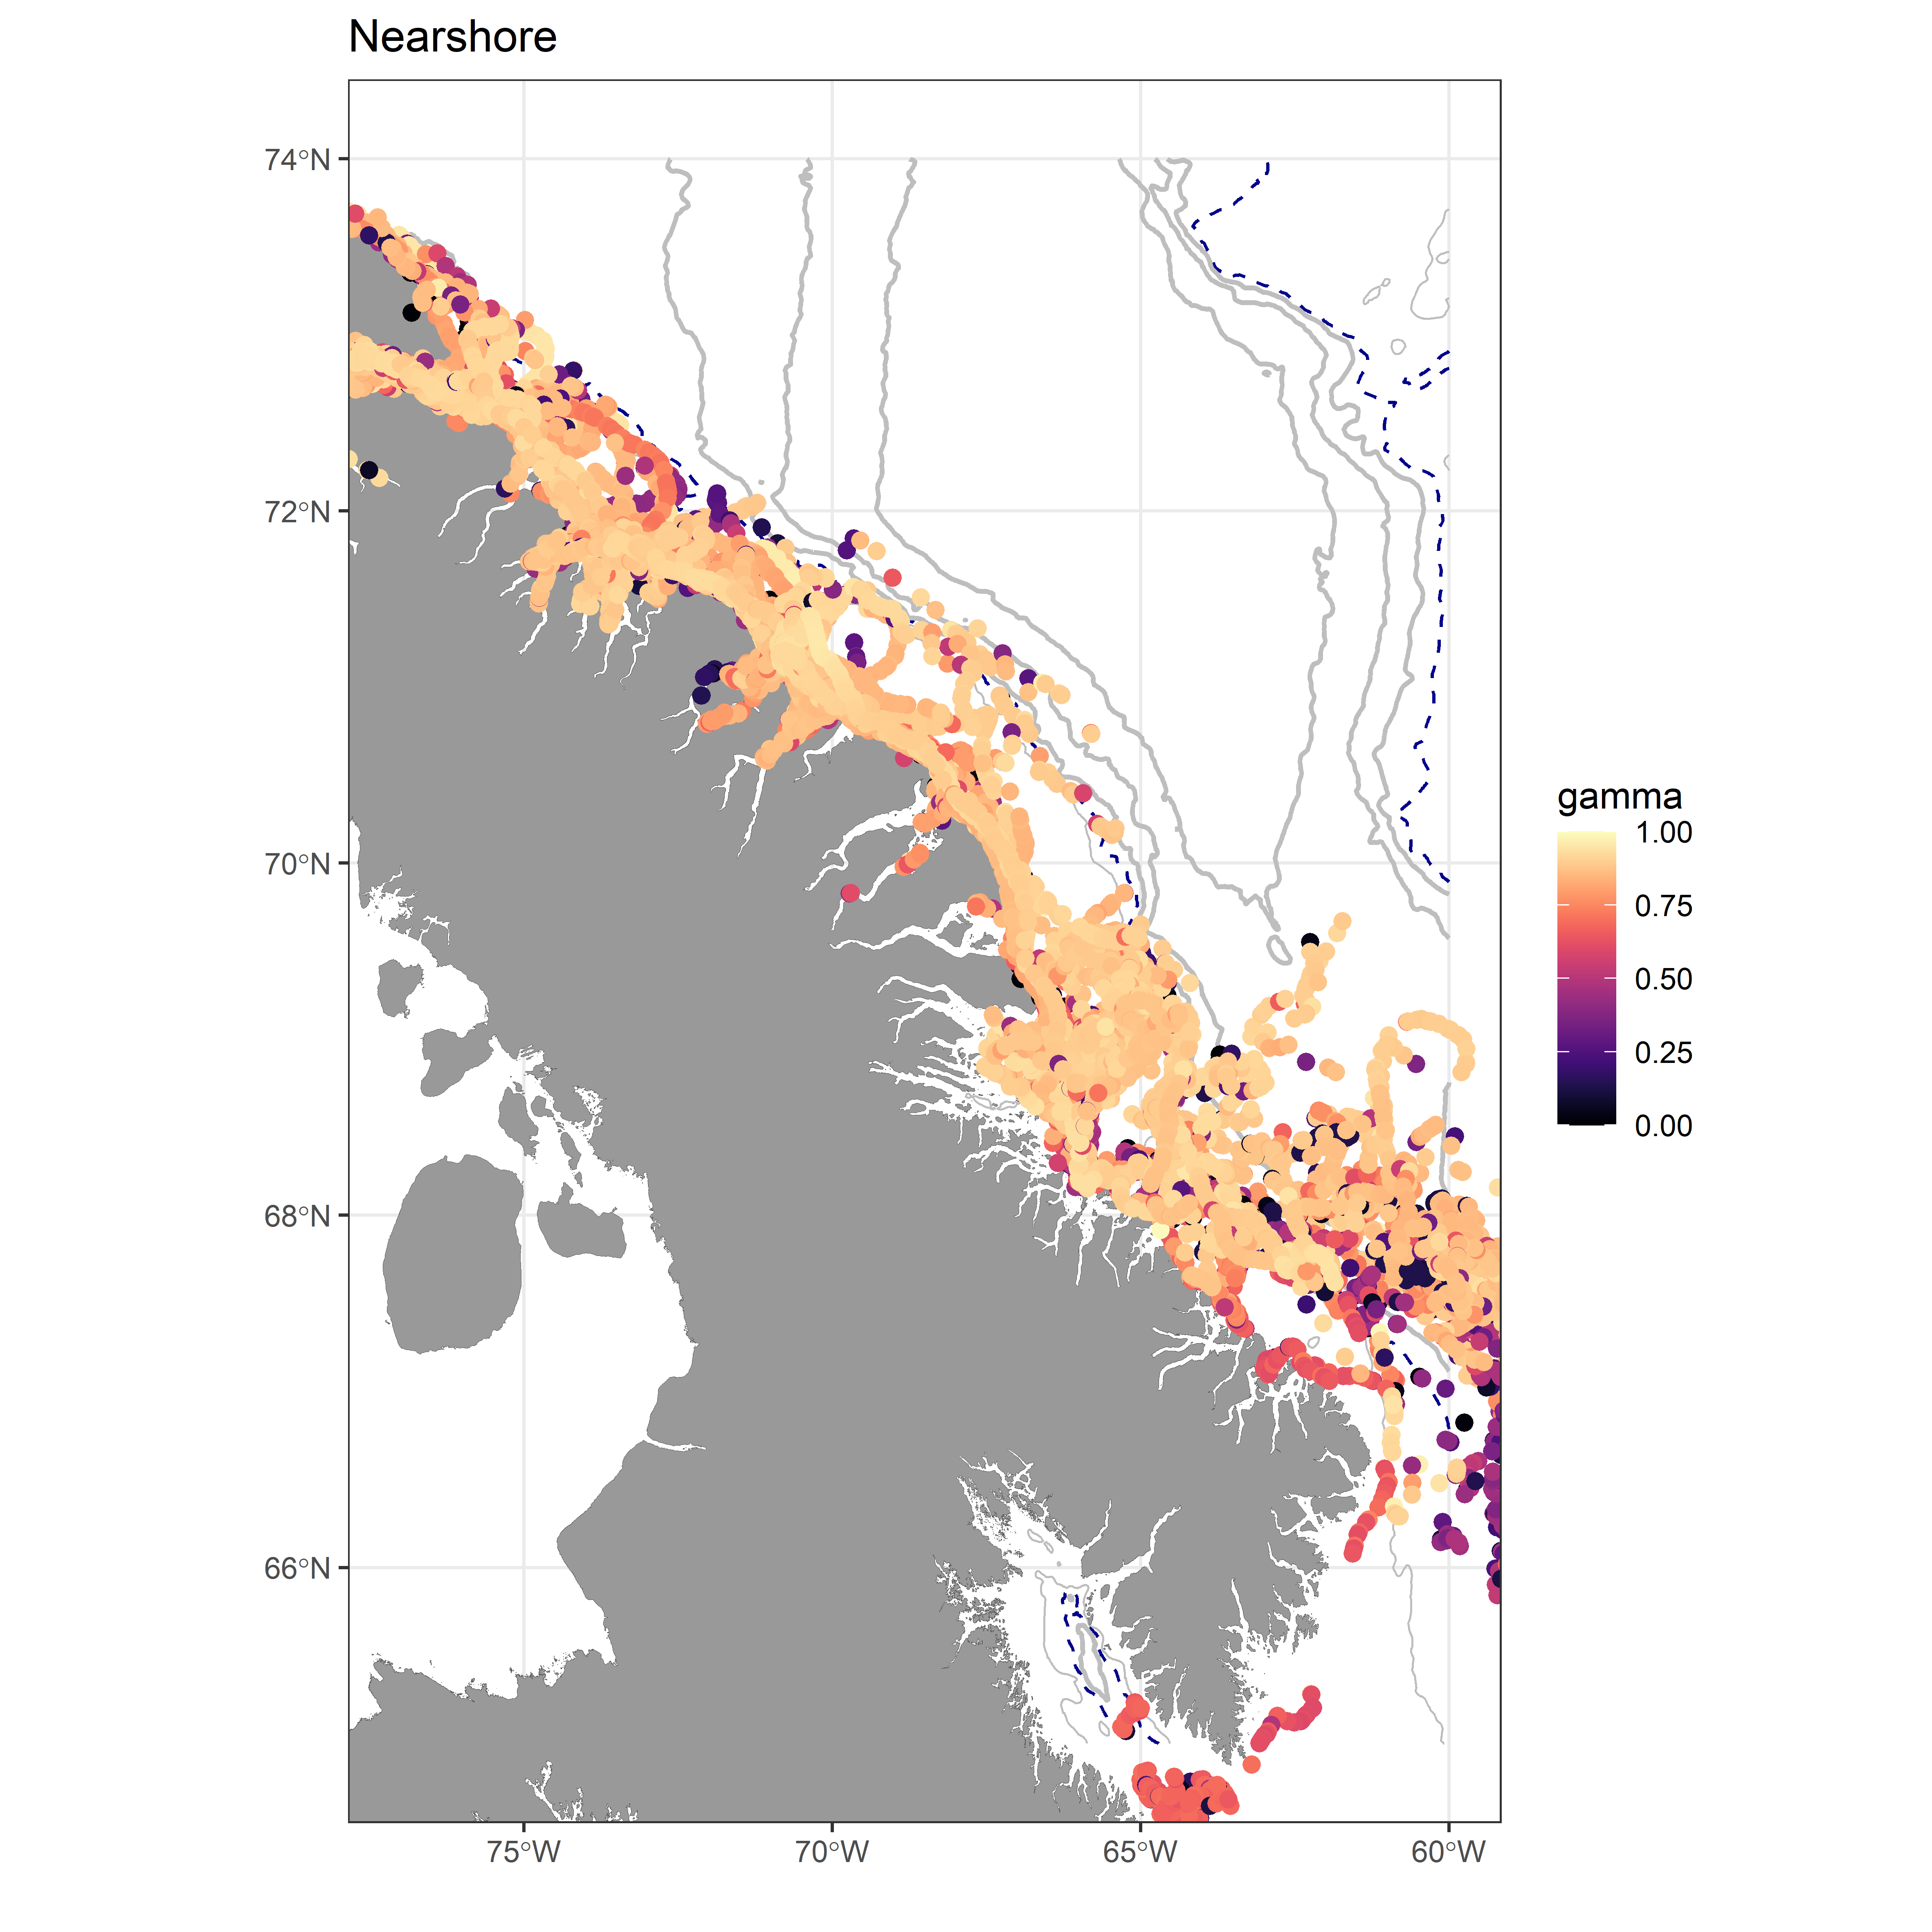
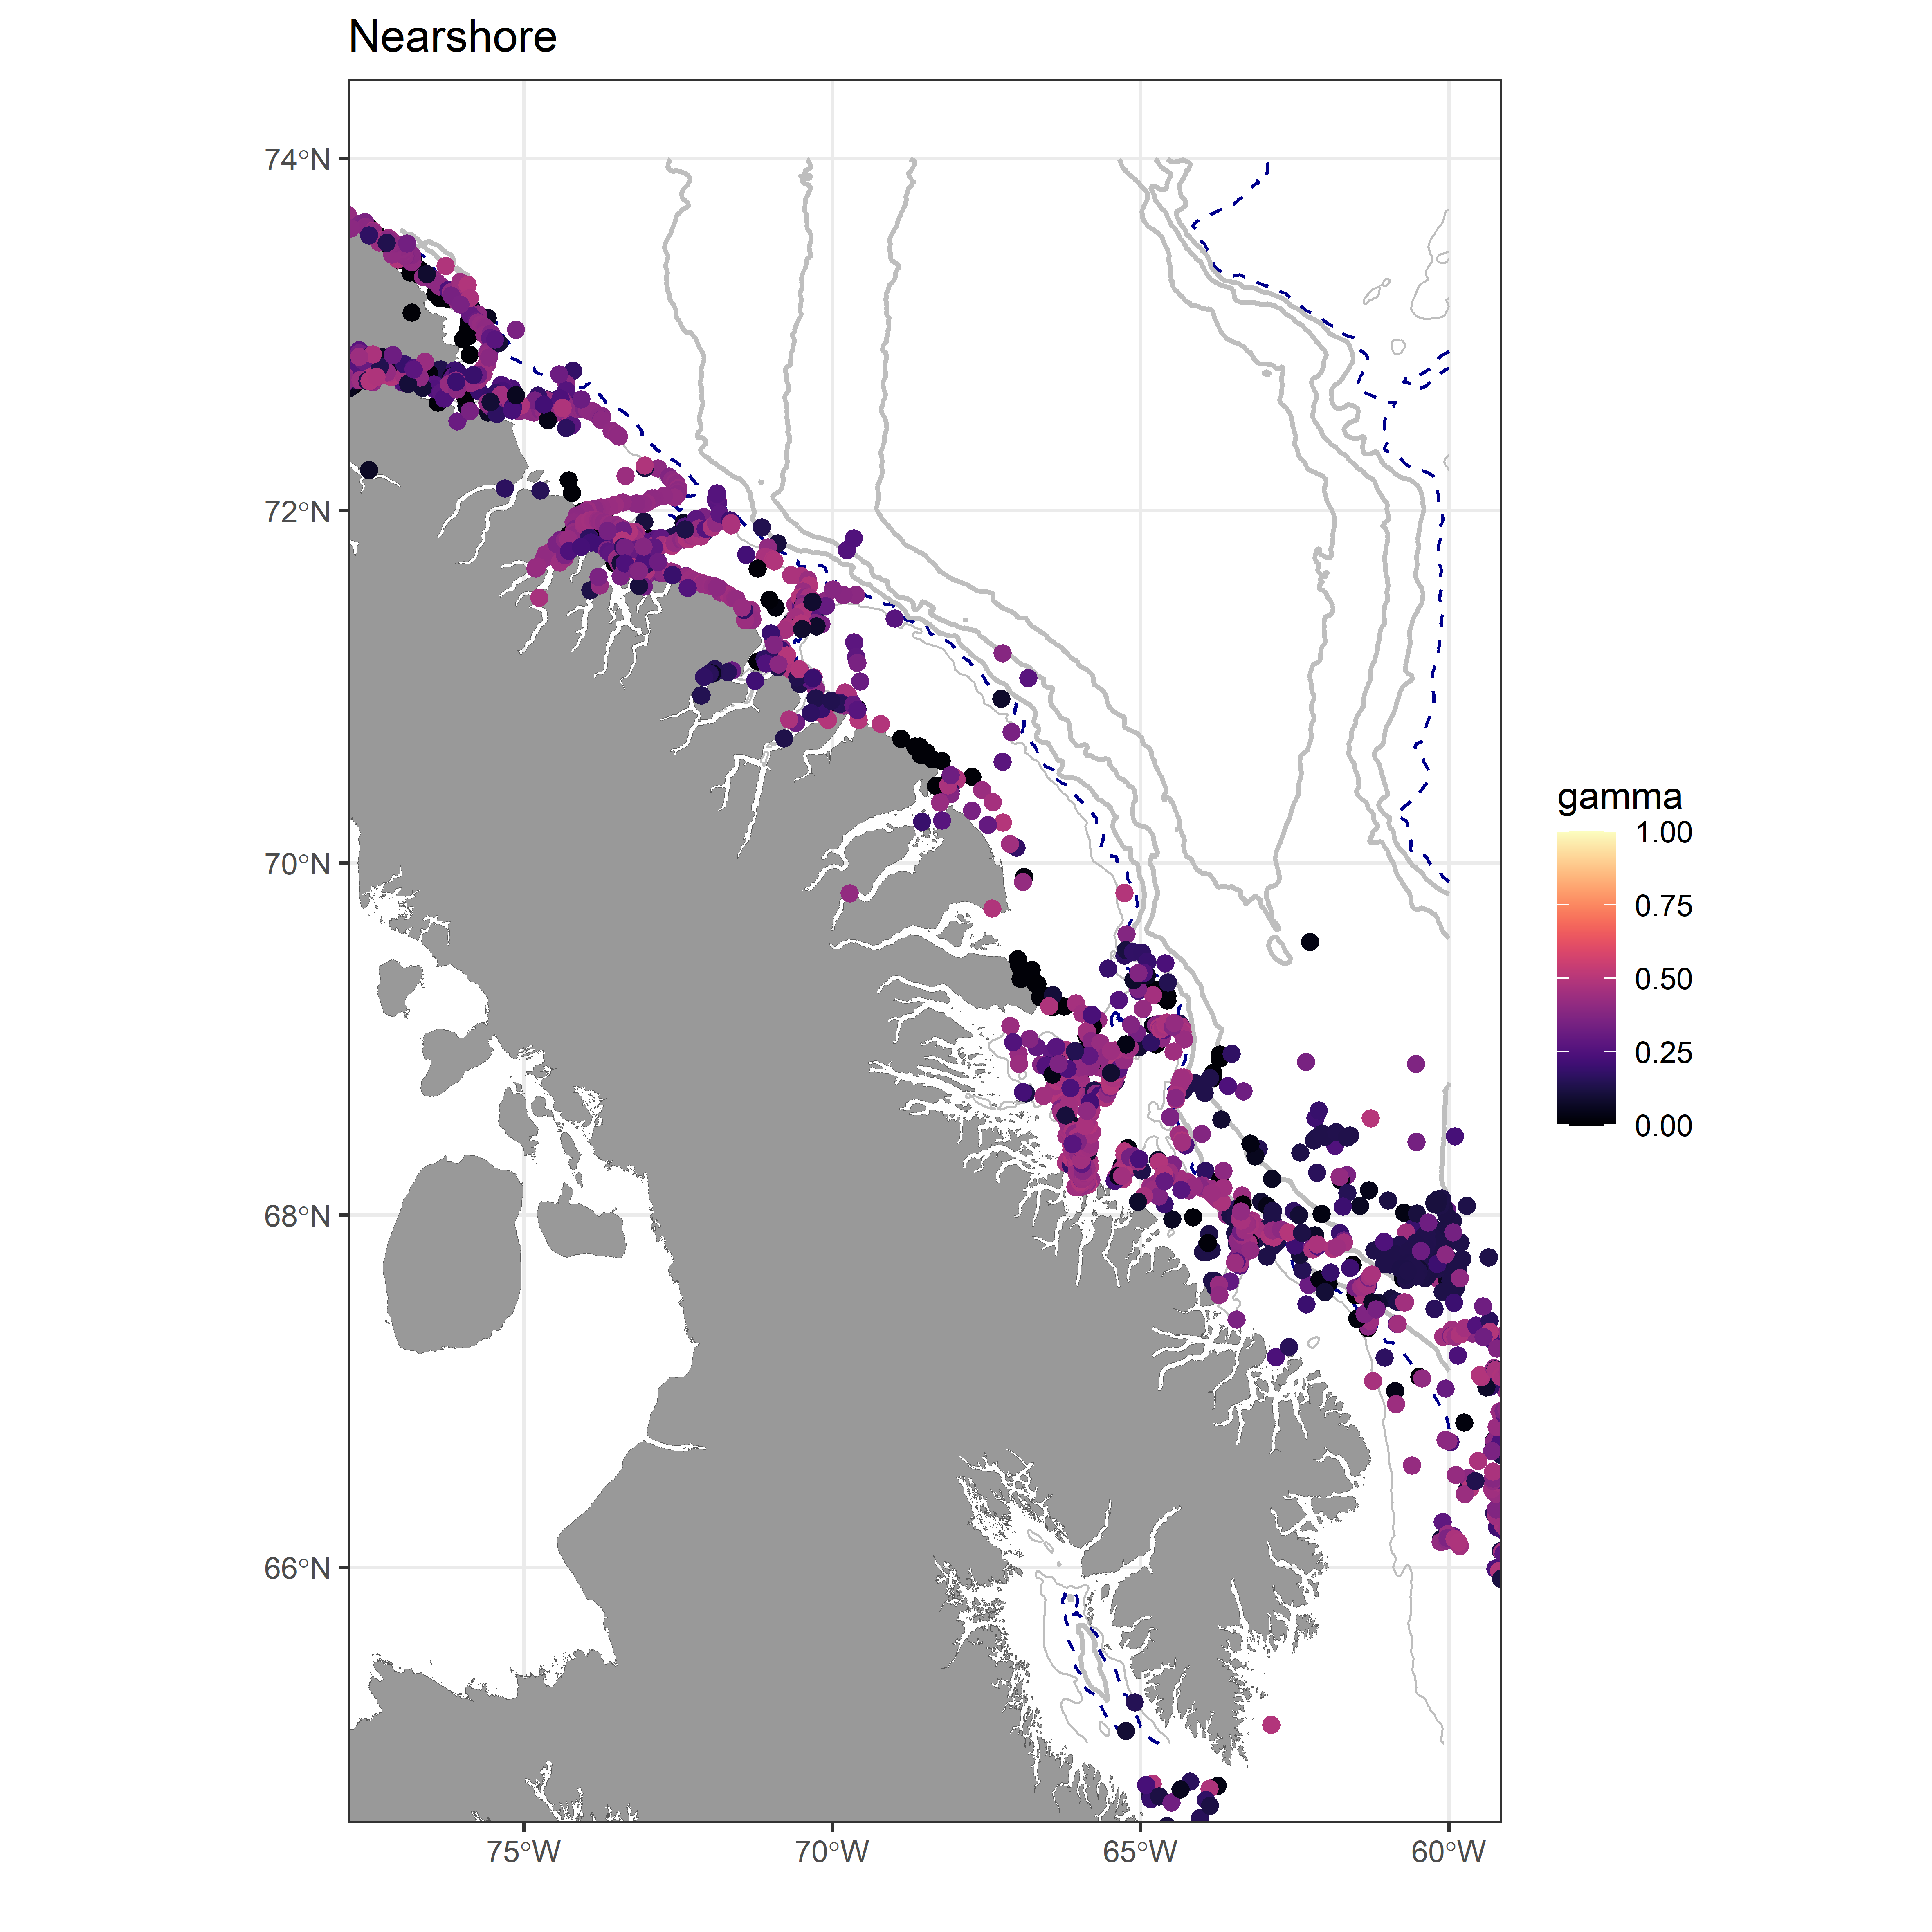

Migration corridors and stop-over sites
Courtney Shuert Former postdoc
Movement characteristic
Directed transiting
Nearshore
Area-restricted stopping over
Project collaborators: Marianne Marcoux, Nigel Hussey, …
Shuert et al. 2023 Movement Ecology
Notes:
We are using state-space models (similar to the one I talked about in the previous talk), we looked at the movement coridors of narhwhal 20+ years. We have found that there are two general corridors offshore spending most of their tie targeting deeper waters, and nearshore corridors along Baffin Island. The model uses the movement data to assess wether parts of the range is associate with more directed movement or more are-restricted search (which we associated with stop-over sites). When we focuss on Ars, we see that especially the nearshore ones are stopping at the canyon.
Notes
#####
Filtered for gamma < 0.5
Offshore seem to be targeting the deep water as expect, but hugging the 1500 m contour
Nearshore use both fjord systems, but also seem to be targeting the canyon systems along Baffin Island – some stopping along shelf break as well.
350 – 700 – 1000 – 1500 – 2000
The dashed line is the 700 m isobath which separated the nearshore/offshore

Slide 33
State-space models
Two-step approach (today’s focus)
Step 1: simple model to remove error (and regularize)
Step 2: analysis of interest
(e.g., resource selection function)
Pros:
Many R packages
Fast to fit
Con:
don’t propagate error (except if we use multiple imputation)
Model that handles error and includes analysis of interest (Friday’s focus)
Pro:
propagate error
Cons:
Often involves hard-coding model
Often slow

Slide 34

Courtney Shuert Former postdoc
Project collaborators: Marianne Marcoux, Nigel Hussey, …
Shuert et al. 2023 Movement Ecology
Notes:
We are using state-space models (similar to the one I talked about in the previous talk), we looked at the movement coridors of narhwhal 20+ years. We have found that there are two general corridors offshore spending most of their tie targeting deeper waters, and nearshore corridors along Baffin Island. The model uses the movement data to assess wether parts of the range is associate with more directed movement or more are-restricted search (which we associated with stop-over sites). When we focuss on Ars, we see that especially the nearshore ones are stopping at the canyon.
Notes
#####
Filtered for gamma < 0.5
Offshore seem to be targeting the deep water as expect, but hugging the 1500 m contour
Nearshore use both fjord systems, but also seem to be targeting the canyon systems along Baffin Island – some stopping along shelf break as well.
350 – 700 – 1000 – 1500 – 2000
The dashed line is the 700 m isobath which separated the nearshore/offshore

Slide 35
State-space models
Two-step approach (today’s focus)
Step 1: simple model to remove error (and regularize)
Step 2: analysis of interest
(e.g., resource selection function)
Pros:
Many R packages
Fast to fit
Con:
don’t propagate error (except if we use multiple imputation)
Model that handles error and includes analysis of interest (Friday’s focus)
Pro:
propagate error
Cons:
Often involves hard-coding model
Often slow

Slide 36

Multiple imputation

Slide 37




Multiple imputation
$${\hat{θ}}^{(1)}$$
Fit SSM & simulate from posterior
Perform analysis of interest
Combine estimates
$$var\left(\overline{θ}\right)= \\ \sum_{i=1}^{M}{var}\left({\hat{θ}}^{(i)}\right)+ \\ \left(1+\frac{1}{M}\right)\left[\frac{1}{M−1}\sum_{i=1}^{M}{{\left({\hat{θ}}^{\left(i\right)}−\overline{θ}\right)}^{2}}\right]$$
$${\hat{θ}}^{(2)}$$
…
$${\hat{θ}}^{(M)}$$
Notes:
Need to check Brett’s paper. Slide made quickly.

Slide 38
Let’s start applying these concepts in R!

